Slide 1
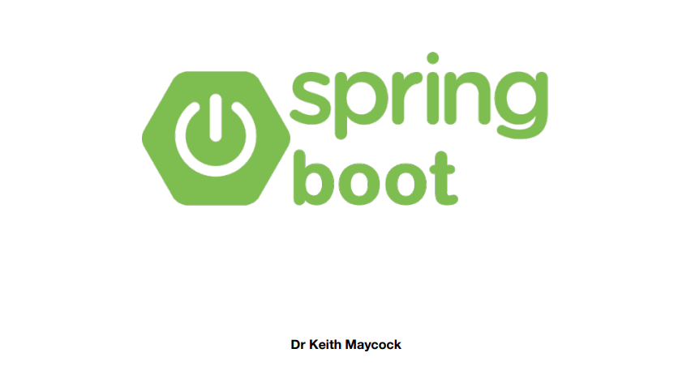

Slide 2
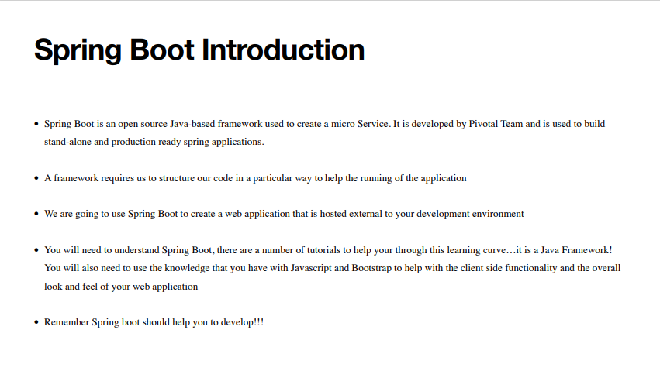

Slide 3
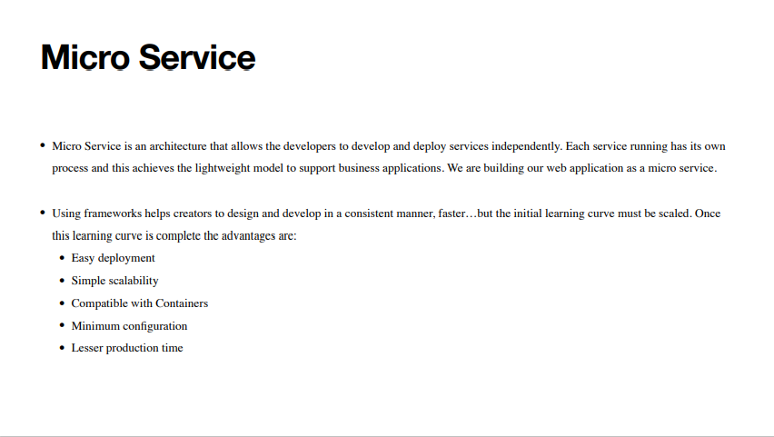

Slide 4
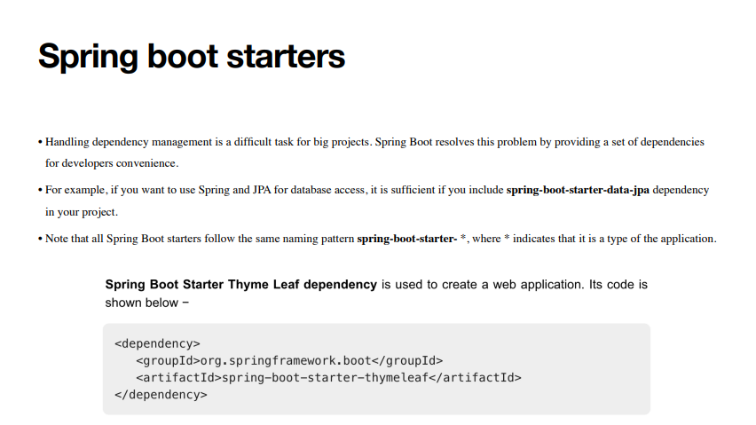

Slide 5
Tutorial 1: Hello World
Every programming language starts with a Hello World application. This tutorial from the spring.io guys
Looks at creating a web application that allows a user to pass a name as a parameter and captures this
parameter to display it on the display.
The screen shots within this presentation are from Visual Studio Code

Slide 6
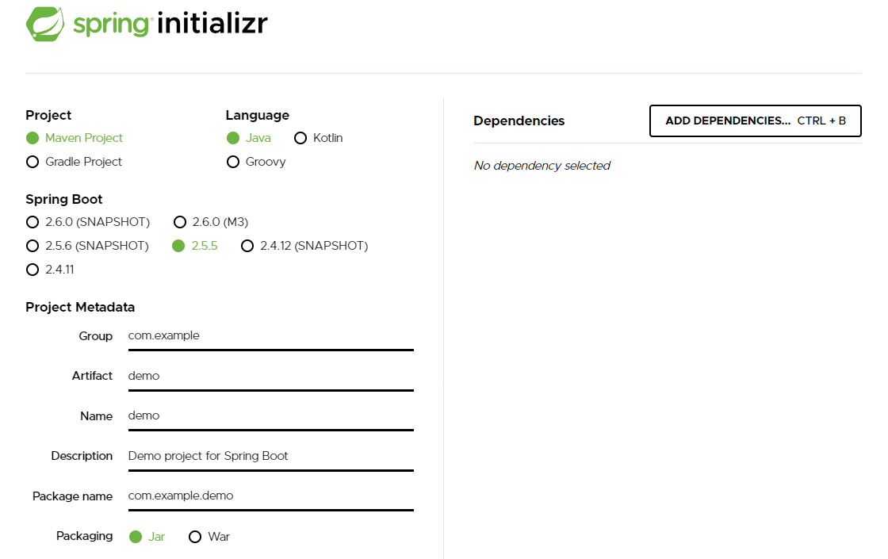
Step 1: Creating a new Project
The best way to jump start your development is to use the spring initializer found at start.spring.io. This allows us to tell spring what dependencies we will need for the project.

Slide 7
Maven or Gradle
Maven and Gradle are tools that are used to help build software.
Maven is an open-source project management tool. This tool is focused on the development of software in a standard layout fast. Maven uses XML to help structure the application.
Gradle is also an open-source tool that helps to create software. Gradle supports the creation of mobile and web applications with testing and deploying on various platforms. With its functionality, it is preferred as an official tool for developing Android applications.

Slide 8
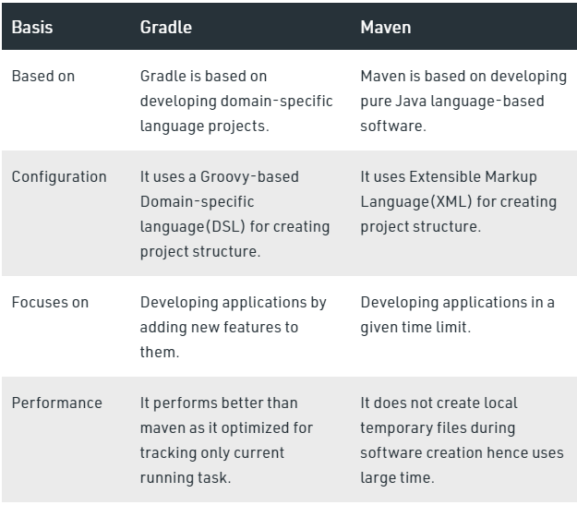
Maven or Gradle

Slide 9
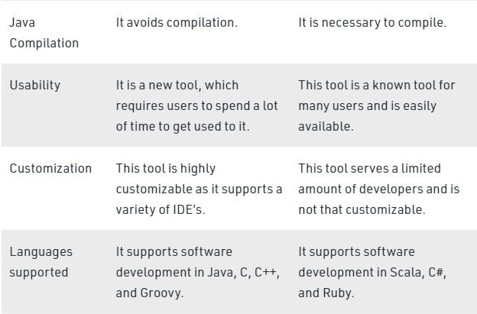
Maven or Gradle

Slide 10
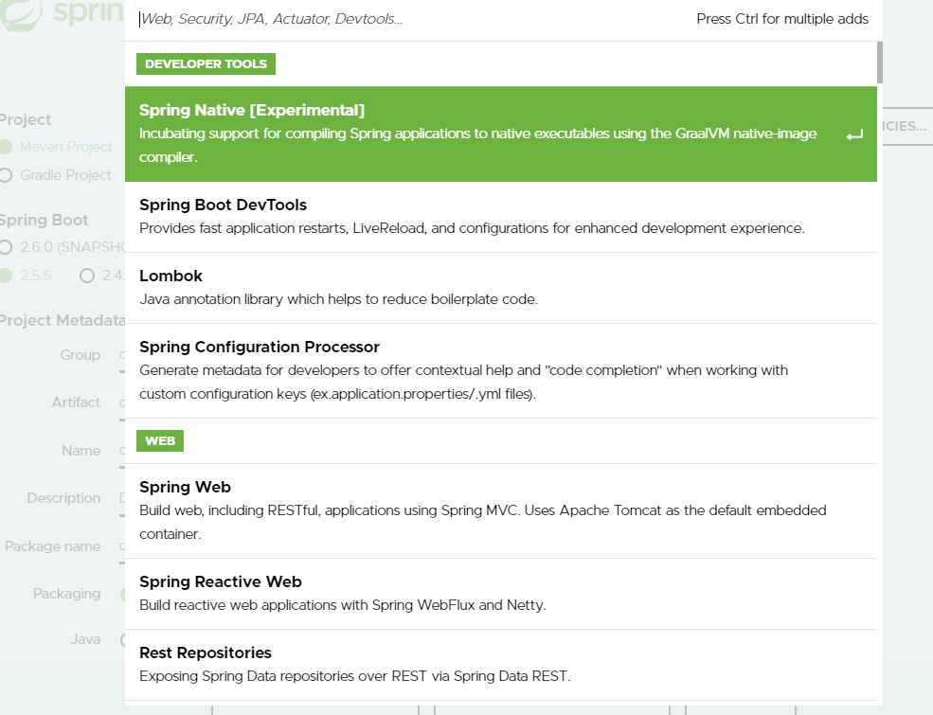

Slide 11
Modify the Code
We would like to add to the initial codebase to allow for a GET request that is going to be handled by the app to display a suitable message…
What should happen is that when a GET request is triggered at an endpoint a method should be called

Slide 12
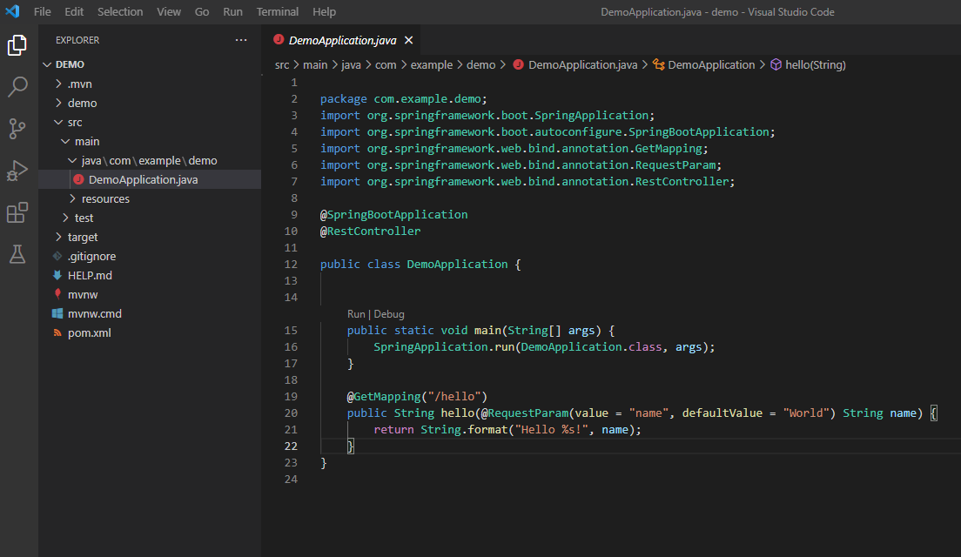

Slide 13
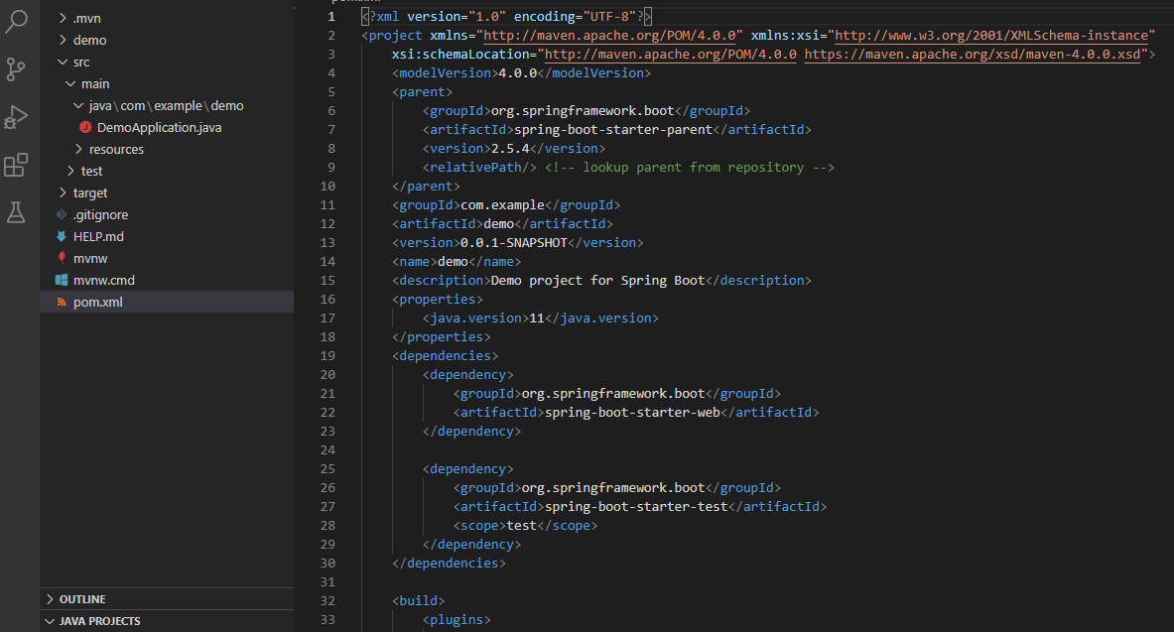

Slide 14
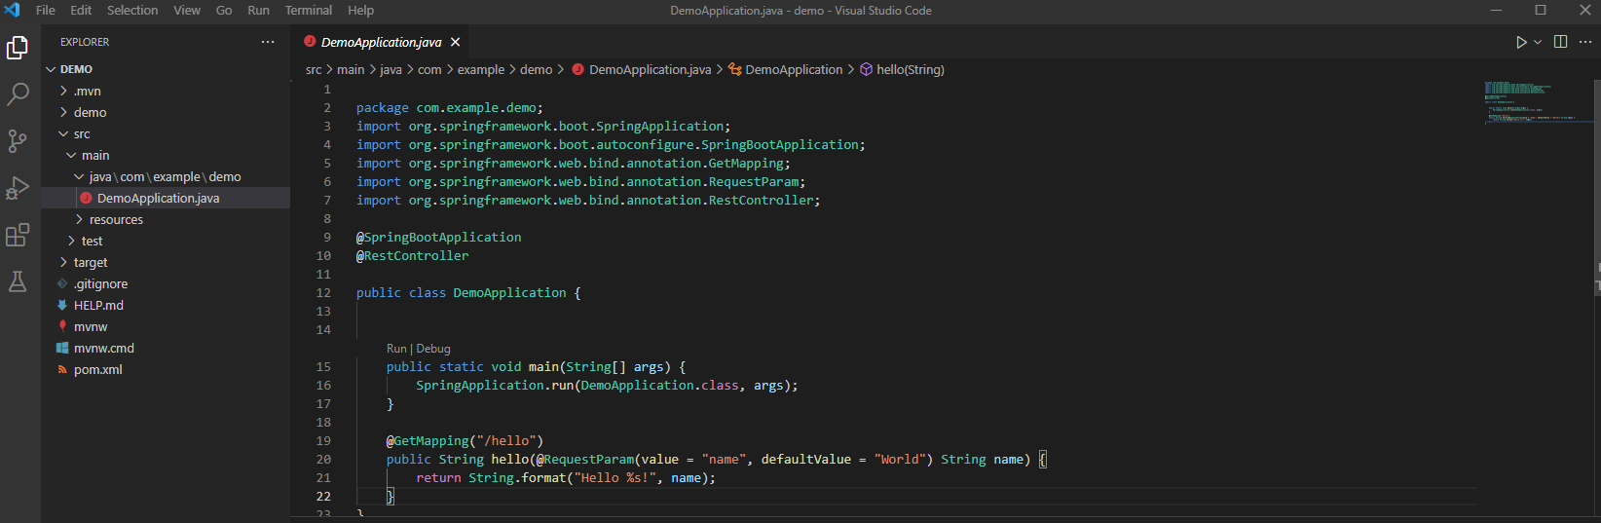

Slide 15
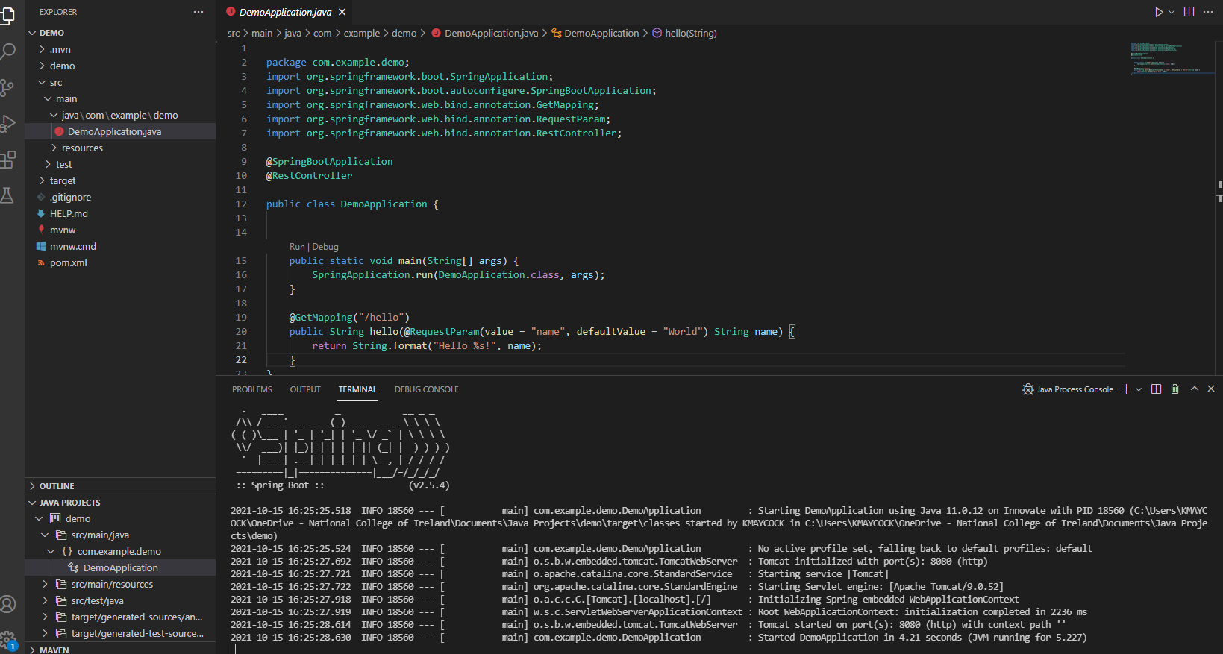

Slide 16
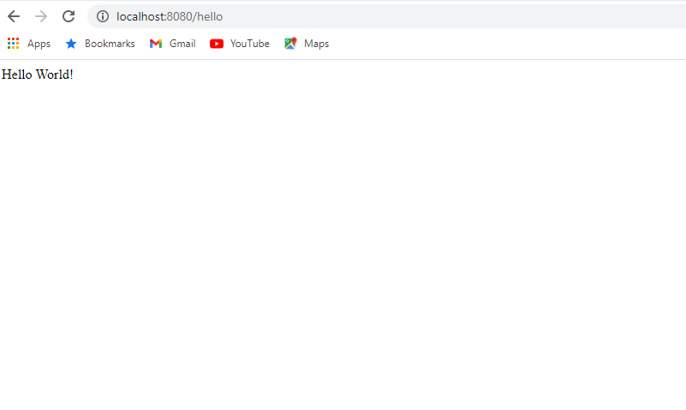

Slide 17
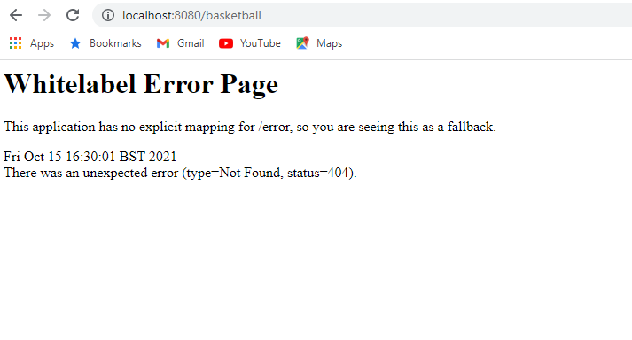

Slide 18
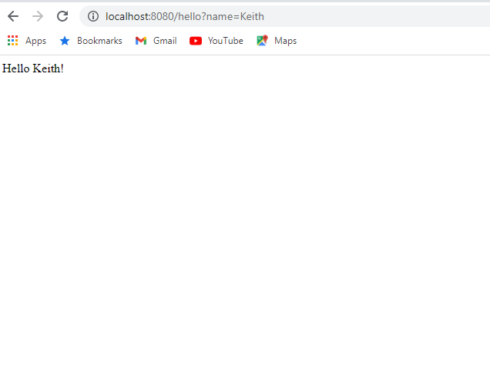

Slide 20
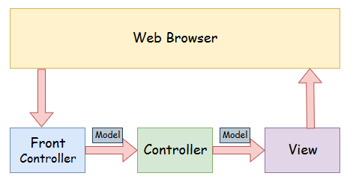
Spring MVC is designed to follow a Model-View-Controller design pattern

Slide 21
Spring MVC
Model - A model contains the data of the application. A data can be a single object or a collection of objects.
Controller - A controller contains the business logic of an application. Here, the @Controller annotation is used to mark the class as the controller.
View - A view represents the provided information in a particular format. Generally, JSP+JSTL is used to create a view page. Although spring also supports other view technologies such as Apache Velocity, Thymeleaf and FreeMarker.
Front Controller - In Spring Web MVC, the DispatcherServlet class works as the front controller. It is responsible to manage the flow of the Spring MVC application.

Slide 22
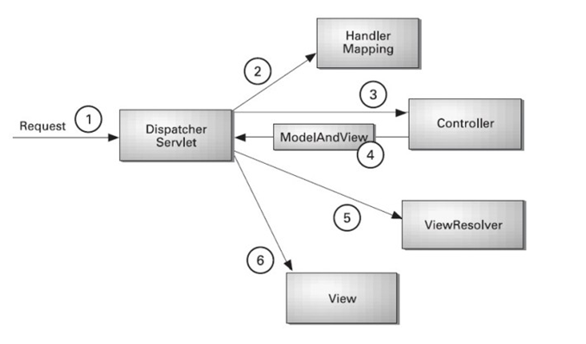
The flow of Spring Web MVC

Slide 23
As displayed in the figure, all the incoming request is intercepted by the DispatcherServlet that works as the front controller.
The DispatcherServlet gets an entry of handler mapping from the XML file and forwards the request to the controller.
The controller returns an object of ModelAndView.
The DispatcherServlet checks the entry of view resolver in the XML file and invokes the specified view component.

Slide 24
Advantages of using Spring MVC
Separate roles - The Spring MVC separates each role, where the model object, controller, command object, view resolver, DispatcherServlet, validator, etc. can be fulfilled by a specialized object.
Light-weight - It uses light-weight servlet container to develop and deploy your application.
Powerful Configuration - It provides a robust configuration for both framework and application classes that includes easy referencing across contexts, such as from web controllers to business objects and validators.
Rapid development - The Spring MVC facilitates fast and parallel development.
Reusable business code - Instead of creating new objects, it allows us to use the existing business objects.
Easy to test - In Spring, generally we create JavaBeans classes that enable you to inject test data using the setter methods.
Flexible Mapping - It provides the specific annotations that easily redirect the page.

Slide 25
Tutorial 2: A Simple MVC Example
You are required to use an MVC approach to building your project. Don’t worry this makes things easier!
In the above tutorial we looked creating a simple Hello World application using our main class.
In this tutorial we
Create a custom controller to handle requests
Explore how we can pass data to the view
Visualise the result from the view page
Create an index page and trigger a GET request that is processed by our controller

Slide 26
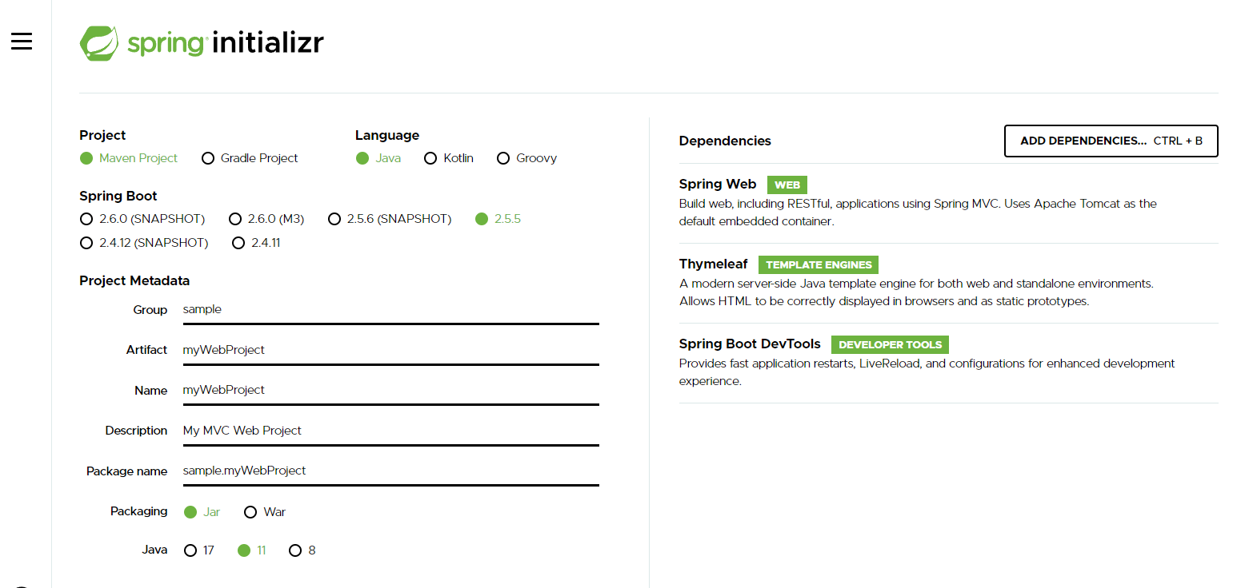

Slide 27
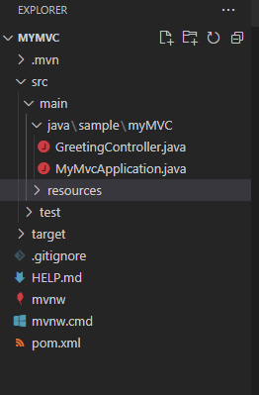
The Controller
The controller is used to handle the HTTP requests. You can easily identify the controller by the @Controller annotation.
We need to create a controller that handles GET requests that arrive at /greeting and then process this request and display a suitable message.
We need to place our controller in the same location as our main class.

Slide 28
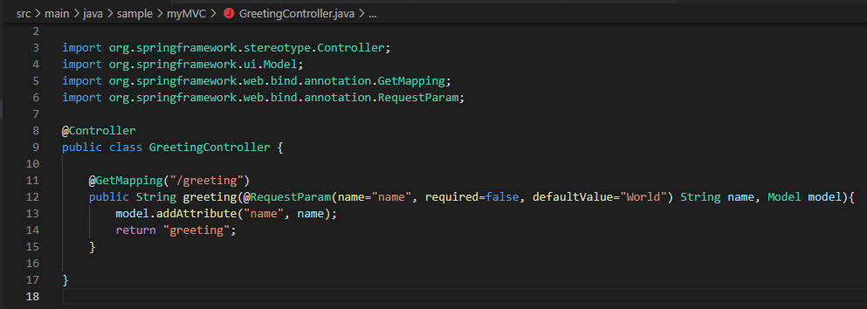
The Controller

Slide 29
The Controller – how it works
The @GetMapping annotation ensures that HTTP GET requests to /greeting are mapped to the greeting() method.
@RequestParam binds the value of the query string parameter name into the name parameter of the greeting() method.
This query string parameter is not required. If it is absent in the request, the defaultValue of World is used.
The value of the name parameter is added to a Model object, ultimately making it accessible to the view template.
The implementation of the method body relies on a view technology (in this case, Thymeleaf) to perform server-side rendering of the HTML.
Thymeleaf parses the greeting.html template and evaluates the th:text expression to render the value of the ${name} parameter that was set in the controller.

Slide 30
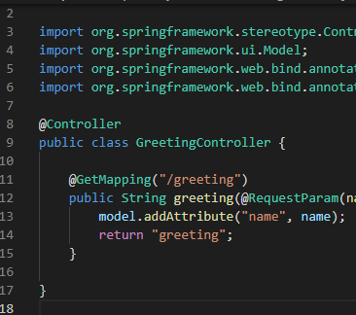
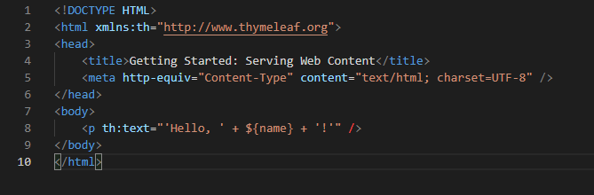
Unlike strict MVC frameworks like Rails we can specify the entry location
of the view within the method

Slide 31
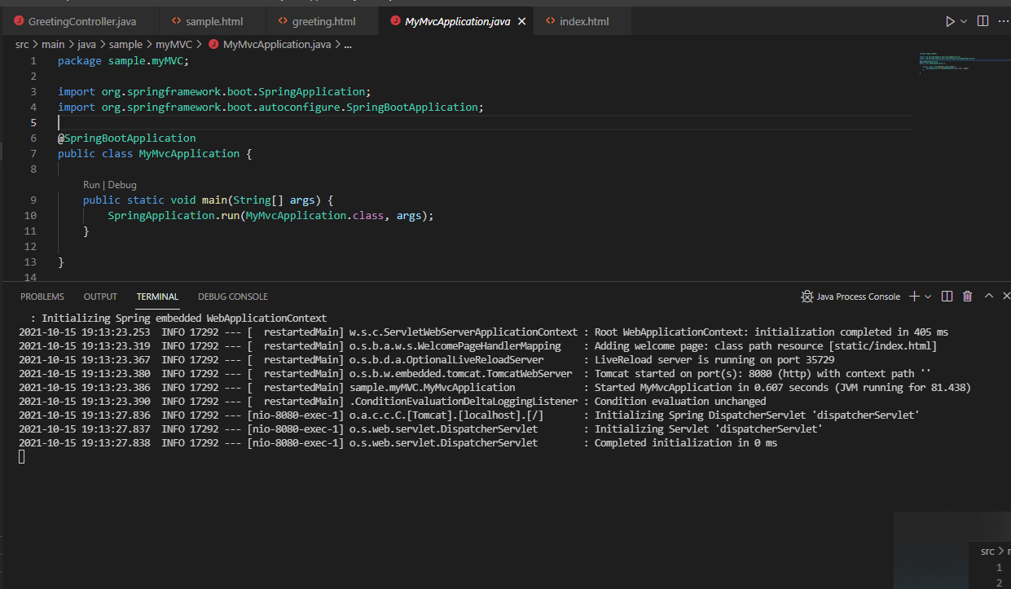
Running the Application

Slide 32
MyMvcApplication
@SpringBootApplication is a convenience annotation that adds all of the following:
@Configuration: Tags the class as a source of bean definitions for the application context.
@EnableAutoConfiguration: Tells Spring Boot to start adding beans based on classpath settings, other beans, and various property settings. For example, if spring-webmvc is on the classpath, this annotation flags the application as a web application and activates key behaviors, such as setting up a DispatcherServlet.
@ComponentScan: Tells Spring to look for other components, configurations, and services, letting it find the controllers.

Slide 33
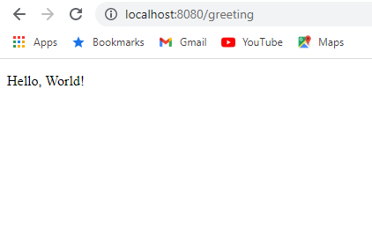
Running the application
When we run our application it may not be pretty but it demonstrates how our MVC framework is working

Slide 34
Add a Home Page
Static resources, including HTML and JavaScript and CSS, can be served from your Spring Boot application by dropping them into the right place in the source code. By default, Spring Boot serves static content from resources in the classpath at /static (or /public).
The index.html resource is special because, if it exists, it is used as a welcome page located at localhost:8080/
Lets create a simple welcome page that enables a user to trigger a GET request to the greetings page…

Slide 35
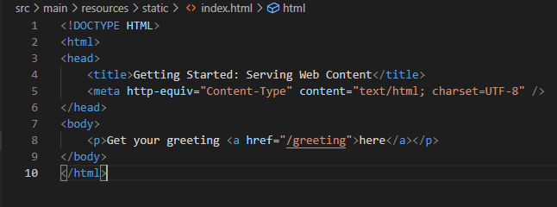
Home Page

Slide 36
ToDo
Create a simple MVC web application that uses a controller to demonstrate how to handle a GET request. The page should have an index page with two buttons that direct traffic to two separate controllers rendering different views.
Style your application using bootstrap and add extra UI elements to show how javascript is working in your application

Slide 37
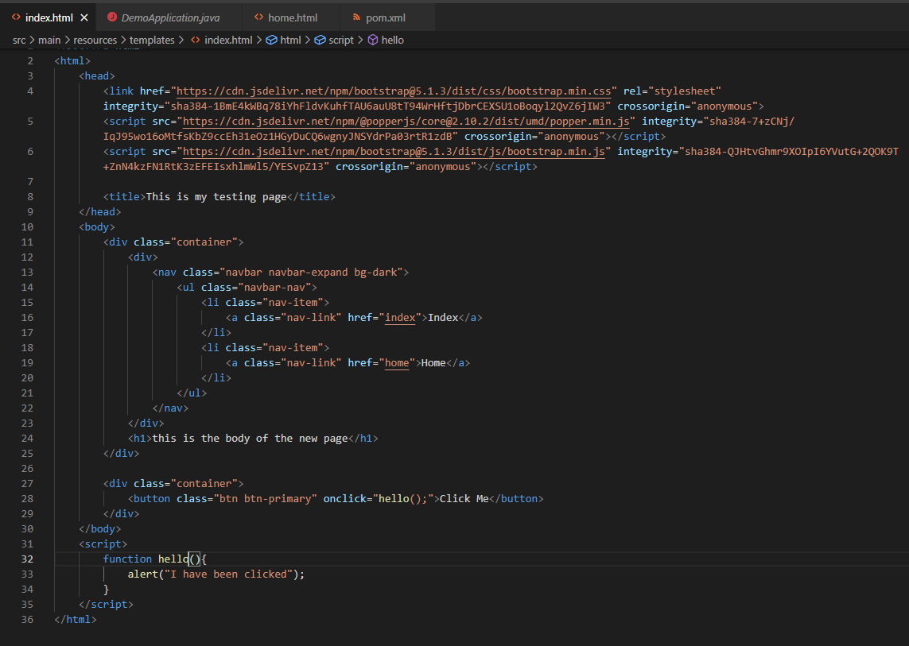
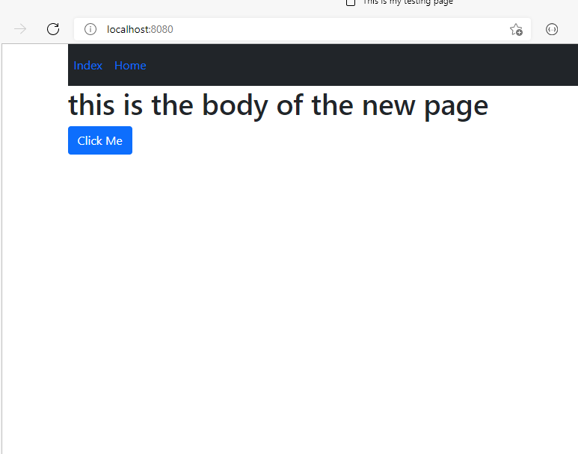
What is your project going to look like?

Slide 38


